Slide 1
Having a Life: Social Inclusion for People with IDD
Matthew Bogenschutz, Ph.D.
Virginia Commonwealth University
School of Social Work & Virginia LEND

Slide 2
Presentation Overview
Your Good Life
Definitions & Domains
What Do We Know
Where Do We Go

Slide 3
Take a Moment to Think…
What are your happiest memories in life?
What were you doing?
Who were you with?
What factors brought you to that point?

Slide 4
Connection and Interest
For most of us our happiest times in life are times we have spent with family and friends doing things that interest us.
But it takes a lot of effort for any of us to build connections with others, and we need to have a variety of experiences to find our interests

Slide 5
The Challenge
For people with IDD, access to personal networks and social experiences can be limited:
Societal stigma
Limited resources & support
The changing nature of social interaction
We need to be creative in order to meet the challenge of social inclusion for people with IDD!

Slide 6
Definitions and Domains

Slide 7
What Social Inclusion is Not
Physical presence is not an adequate substitute for social inclusion
While community living has improved physical inclusion (being in a neighborhood), social inclusion has not necessarily followed (being of a neighborhood)
Being of a community takes much more than simply being in a community

Slide 8
Basic Elements of Social Inclusion
Social Inclusion
Relationships
Leisure/
Activities
Productive Activities
Employment
Accommodations
Supports (formal & informal)
Accepted as an Individual
Shared by Hall (2009) and Martin & Cobigo (2011)
Unique to Hall (2009)

Slide 9
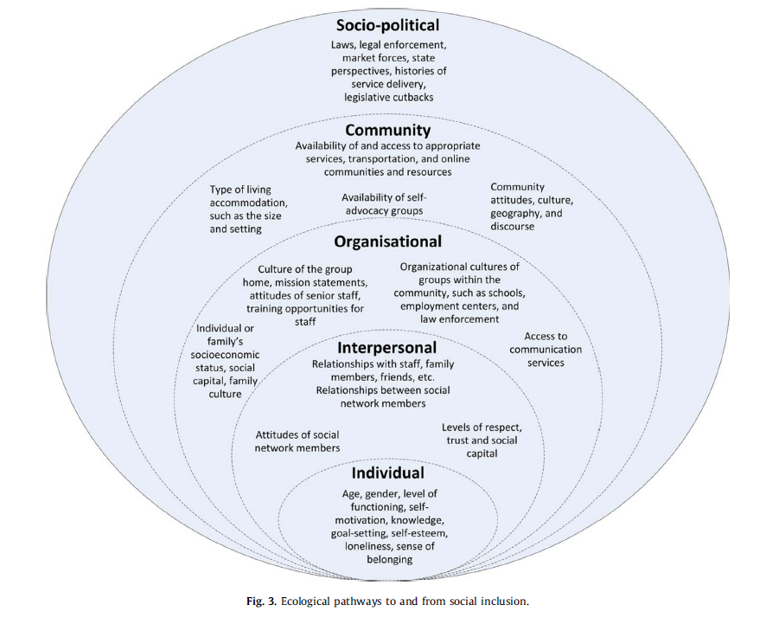
Socio-ecological Context
Simplican and colleagues (2015) proposed a model that looks at interpersonal relationships and community participation across five levels of the socio-ecological continuum.

Slide 10
Measuring Social Inclusion
In the absence of an agreed upon way to define inclusion, measurement is difficult. Often, the following factors are considered:
Number of times in the community per week/month
Who did the activity happen with (staff, friend with IDD, friend without IDD, family, etc.)
How much choice a person had about the activity
But there’s no consensus on measuring SI, making it difficult to draw good research conclusions based on interventions… we don’t really know how we’re doing to support social inclusion.

Slide 11
What Does All of this Mean?
These dimensions of social inclusion are not just an academic matter… they matter to people with IDD.
Let’s listen to one person’s description of what social inclusion means for him.

Slide 12
Hunter Sargent

Slide 13
What we Know about Social Inclusion for People with IDD

Slide 14
Personal Relationships: Friendship
Social networks of people with IDD tend to be small and dominated by staff, family, and other people with IDD:
Median network size is 2. Only 30% have a person who is not staff, family or another person with IDD in their network (Robertson et al., 2001)
On average, a person with IDD had only two engagements with a friend in a two week period – none typically with someone w/o IDD (Emerson & McVilly, 2004)
Average network size is 22. Only 11% were friends w/o IDD (Forrester-Jones et al., 2006)
Social networks of people with IDD are small even when compared with people with physical disabilities (Lippold & Burns, 2009)

Slide 15
Personal Relationships: Friendship
Studies in the UK (Forrester-Jones, 2007) and Ireland (McConkey, 2007) revealed better social inclusion among people living in community settings, when compared to large aggregate settings.
Direct support professionals are essential to supporting social inclusion, but we know:
DSPs rate care tasks as more important than social tasks (McConkey & Collins, 2010)
Group homes with staff-centered cultures tend to have poor inclusion outcomes (Bigby et al., 2012)

Slide 16
Personal Reln: Intimate Relationships
Feelings of love are similar for people with and without IDD (Morales et al, 2004), and love appears to be associated with emotional well-being (Arias, Oveijero & Morentin, 2009)
People with IDD see intimate relationships as being different from other relationships. Intimate relationships (Knox & Hickson, 2001):
Evolve over time, with planning for the future
Take effort to grow and maintain
Are marked by intimacy, attraction, and spending time together

Slide 17
Personal Relationships: Sexuality
People with IDD are generally aware of their sexual rights, and have basic understanding of anatomy and pregnancy (Healy et al., 2009)
Parental caregivers tend to view sexuality more conservatively than DSPs (Cuskelly & Bryde, 2004; Evans et al., 2009), and sometimes serve as a barrier to sexual engagement (Healy et al., 2009)
Ambivalence in supporting same-sex relationships was found among parents and DSPs alike (Abbott & Howarth, 2007).

Slide 18
Community Participation: Neighborhoods
Negative attitudes about people with IDD among community members may contribute to difficulties with neighborhood inclusion (Abbott & McConkey, 2006).
However, community members are open to more inclusion of people to IDD when they are supported in doing so (Amado et al., 2012).
DSPs play a central role in supporting people with IDD in their neighborhoods (Kozma et al, 2009) and in fostering positive community attitudes (Amado et al., 2011; Van Alphen et al., 2009).
Seattle worked on creating inclusive neighborhoods successfully through local-level initiatives (Carlson, 2000). More on this later…

Slide 19
Community Participation: Recreation & Leisure
People with IDD typically spend large portions of their free time in solitary and sedentary activities (Buttimer & Tierney, 2005; Oates et al., 2011; Verdonschot et al., 2009).
In Australia, participation in an older adults group (Wilson et al., 2013) and in volunteer activities (Trembath et al., 2009) helped people with IDD transition into inclusive retirement
Increasing participation in inclusive recreation will require better recreational education for both people with IDD (Dattilo, 2013) and among leisure and recreation service providers (Duvdevany, 2008). Unified sports approaches are a good step (McConkey et al, 2019)

Slide 20
Community Participation: Faith Communities
Spirituality often contributes to quality of life for people with IDD (Poston & Turnbull, 2004), and guidelines have been developed to help create inclusive faith communities (Carter, 2007; Gaventa, 2008)
Amado and colleagues recently evaluated two programs aimed at fostering inclusive congregations:
In 76% of participating congregations, at least some members reported enduring friendships between people with and without IDD after the Accessible Congregations Campaign (Amado et al., 2012).
The BeFrienders program increased disability awareness, fostered closer relationships and helped members recognize gifts in all people, while transportation, communication and inaccessible facilities hindered integration (Amado et al., 2013).

Slide 21
What Works?

Slide 22
Moving Beyond Presence
Many of the initiatives that have been successful in intentionally in thinking about inclusion that goes beyond presence
For example:
Seattle neighborhoods project
Accessible Congregations Campaign

Slide 23
Mixed Greens

Slide 24
Plan to Spark Interests
Person-centered planning practices are crucial for unlocking a person’s interests, and can often provide a guide for how to support social inclusion.
Write social inclusion into plans
Monitor, evaluate, and recalibrate

Slide 25
Build on Natural Connections
We all feel most comfortable in social situations where we know someone. For people with IDD this natural connection is particularly important.
Neighbors, co-workers, etc. can be great ambassadors to other venues for social engagement.
Matching people with and without IDD who share a common interest can be effective, but difficult to scale up.

Slide 26
Provide Adequate Support
Support is a two-way process when building social inclusion:
Community members and recreation providers must be educated on how to best support people with IDD.
People with IDD must have adequate supports to engage with their communities

Slide 27
Connect Across the Lifespan
We know that it’s easier to build inclusive communities when people are in school… the earlier the better.
But those school bonds can fade over time
Being intentional about fostering relationships as children develop can help improve social inclusion later in life.

Slide 28
Where do we go from here?

Slide 29
Inclusion in a Digital Age
The way people interact has gone increasingly virtual, but people with IDD have largely been left out of digital life
Accessibility difficulties (cost, internet access, app usability, language, etc.)
The different nature of online vs. IRL relationships
How we adapt to support people with IDD in virtual spaces will likely determine future social inclusion outcomes.

Slide 30
Risk vs. Opportunity
Particularly in light of COVID-19, there is likely to be renewal of protectionist attitudes that have served to exclude people with IDD from their communities.
A major question in coming months and years will be around balancing safety and opportunity for engagement
How can we support safe inclusion?

Slide 31
Critical Role of DSPs & Families
Direct support professionals and families are crucial for supporting social inclusion.
How can we best train and support DSPs and families to help people with IDD play a role in their communities?

Slide 32
Measuring Social Inclusion
Since we do not have a unified understanding of the meaning of social inclusion, we cannot accurately measure it to see if our interventions are working.
Researchers should work with advocates to develop better measures of social inclusion
Those measures should be embedded in studies about other life domains (community living, employment, etc.)

Slide 33
Policy to Support Social Inclusion
Recent policy innovations such as the CMS Final Rule on HCBS and the UN CRPD have social inclusion at their cores.
How will we monitor the effects of these policies on social inclusion?
How can we build on these policy successes to raise expectations further?

Slide 34
Thank you!
Questions & Discussion
Feel free to follow up:
Matthew Bogenschutz
mdbogenschut@vcu.edu

